Slide 1

Further CNNs
1
5
Time to grow a backbone

Slide 2
15.1
Backbones for CNNs.

Slide 3
What are Backbones?
In the context of Convolutional Neural Networks a "backbone" refers to the base part of the network that is responsible for extracting features from the input data
Selecting the right Backbone for the task is crucial as it has an affect on multiple attributes of the model
15.1. Backbones for CNNs.

Slide 4
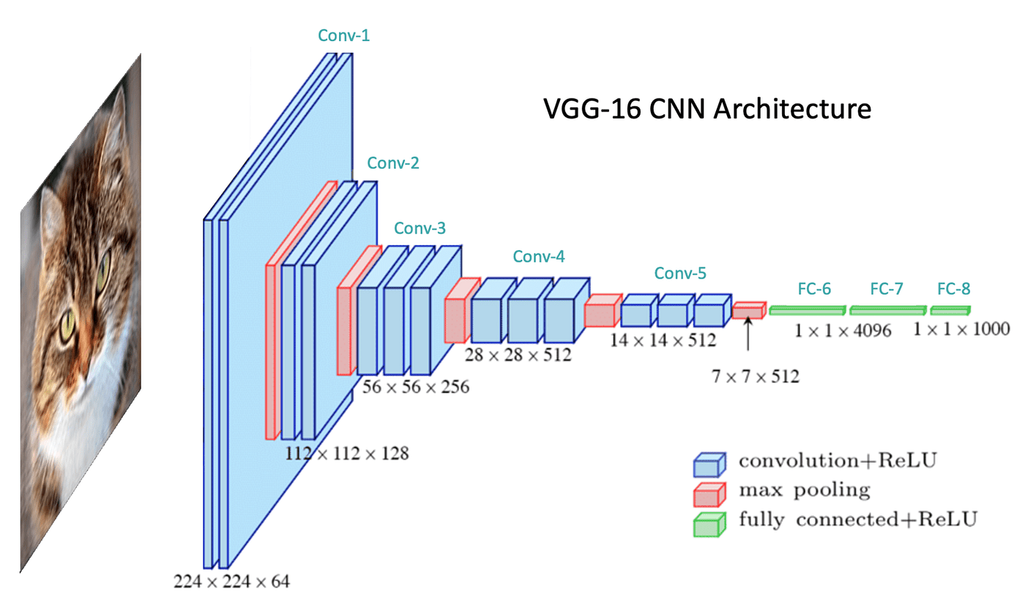
Example of a popular Backbone
15.1. Backbones for CNNs.

Slide 5
Importance of Backbones
Feature Extraction: The primary role of the backbone in a CNN is to extract meaningful features from the input data (images, videos, etc.)
This involves capturing various aspects such as edges, textures, and patterns that are crucial for understanding the content of the data
15.1. Backbones for CNNs.

Slide 6
Importance of Backbones
Hierarchical Processing: CNN backbones typically consist of multiple layers, where each layer builds upon the features extracted by the previous layers
This hierarchical structure allows the network to learn complex and abstract representations of the data
15.1. Backbones for CNNs.

Slide 7
Importance of Backbones
Transfer Learning: A well-trained backbone can be used across different tasks and datasets
This is known as transfer learning, where a backbone trained on a large and diverse dataset (like ImageNet) is reused for other tasks, significantly reducing the training time and data requirements
15.1. Backbones for CNNs.

Slide 8
Importance of Backbones
Efficiency and Performance: The architecture of the backbone affects the efficiency and performance of the CNN
A well-designed backbone can strike a balance between computational efficiency and the ability to capture relevant features, which is vital for deploying models in resource-constrained environments (like mobile devices)
15.1. Backbones for CNNs.

Slide 9
Importance of Backbones
Adaptability: Backbones can be adapted to different scales and complexities of tasks
For instance, lighter backbones like MobileNet are used for applications where speed and low memory footprint are crucial, while more complex backbones like ResNet are used for tasks where accuracy is more important
15.1. Backbones for CNNs.

Slide 10
15.2
Getting a Backbone.

Slide 11
Backbone Architectures for CNNs
There are several popular architectures used in Convolutional Neural Networks
Each has its unique characteristics and applications
15.2. Getting a Backbone.

Slide 12
VGG (Visual Geometry Group)
VGG models, particularly VGG16 and VGG19, are known for their deep architectures with consecutive convolution layers.
They are straightforward but computationally intensive, often used as a baseline for comparison in many computer vision tasks
15.2. Getting a Backbone.

Slide 13
ResNet (Residual Networks)
ResNet architectures, especially ResNet-50, ResNet-101, and ResNet-152, introduced the concept of residual learning with shortcut connections to alleviate the vanishing gradient problem in very deep networks
They are highly influential and widely used for a variety of tasks due to their excellent performance and efficiency
15.2. Getting a Backbone.

Slide 14
MobileNet
Designed for mobile and edge devices, MobileNet architectures use depthwise separable convolutions to reduce the model size and computational complexity while maintaining high performance
They are ideal for applications where resources are limited
15.2. Getting a Backbone.

Slide 15
15.3
Selecting the right Backbone.

Slide 16
How do you choose the right backbone for the job?
Akin to choosing the right tool for the job it is important to choose the right backbone for the task at hand
Choosing between different backbone architectures requires consideration of various factors
Let’s decide between two architectures by asking some key questions
15.3. Selecting the right backbone.

Slide 17
Deciding between ResNet-50 vs VGG16
What is the Complexity of the Task?
Is the task relatively simple (e.g., basic image classification) or complex (e.g., detailed object detection or segmentation)? ResNet-50, with its deeper architecture, is generally better suited for more complex tasks
15.3. Selecting the right backbone.

Slide 18
Deciding between ResNet-50 vs VGG
How Large and Varied is the Dataset?
Deeper networks like ResNet-50 require more data to train effectively without overfitting. VGG16 might be sufficient for smaller datasets
15.3. Selecting the right backbone.

Slide 19
Deciding between ResNet-50 vs VGG
What are the Computational Constraints?
Do you have limitations in terms of computational resources? VGG16 is more computationally intensive, especially in terms of memory due to its fully connected layers, whereas ResNet-50 is more efficient
15.3. Selecting the right backbone.

Slide 20
Deciding between ResNet-50 vs VGG
What is the Required Inference Time?
How fast does the model need to make predictions? If inference speed is a crucial factor, especially in real-time applications, the more efficient architecture (ResNet-50) might be preferable
15.3. Selecting the right backbone.

Slide 21
Deciding between ResNet-50 vs VGG
What is the Training Infrastructure Available?
Do you have access to powerful GPUs or are you working with limited resources? Training deeper networks like ResNet-50 typically requires better hardware
15.3. Selecting the right backbone.

Slide 22
Deciding between ResNet-50 vs VGG
What is the Nature of the Input Data?
Are the input images high-resolution, or do they contain fine-grained details? Deeper networks like ResNet-50 might be better at capturing details in high-resolution images
15.3. Selecting the right backbone.

Slide 23
15.3
Selecting the right Backbone.

Slide 24
END.

